Slide 1
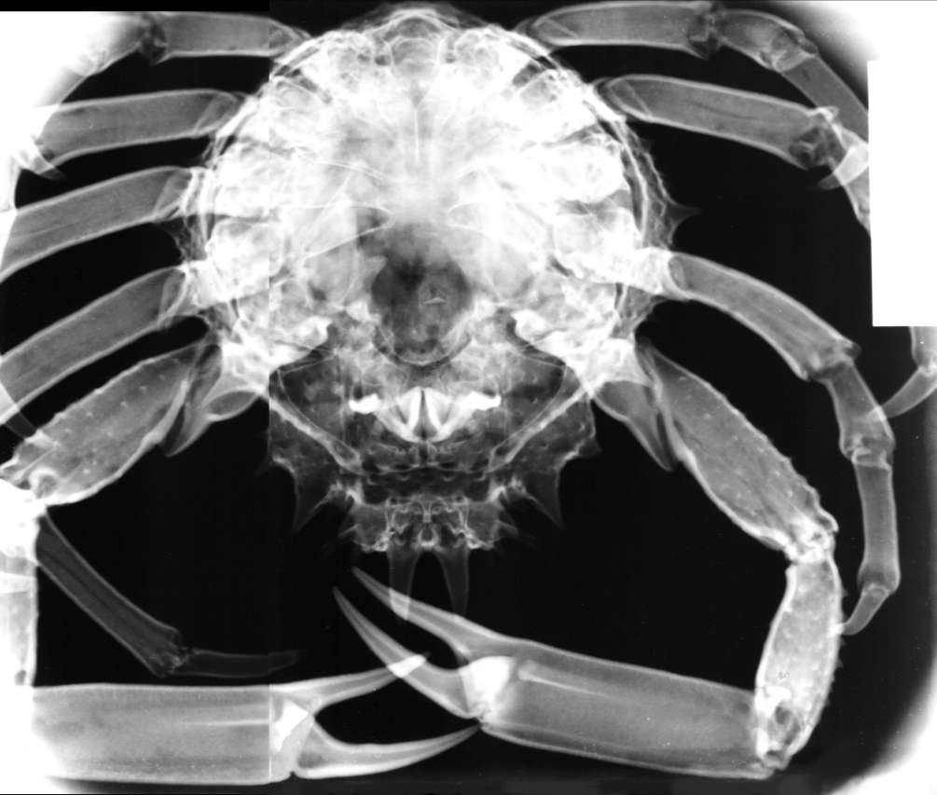
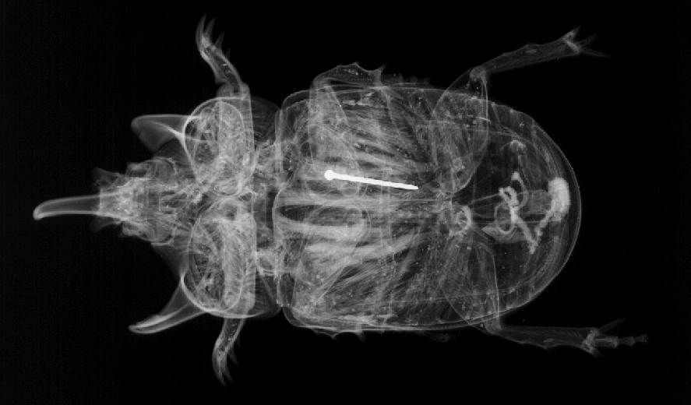
Invertebrates
These are animals without a backbone
There are eight groups of invertebrates
  Arthropods
  nematodes
  Annelids
  Molluscs

Slide 2
Phylum Arthropods
Have several pairs of jointed legs but no backbone
and segmented bodies.
Waterproof exoskeleton – protection in dry land
There are four groups of arthropods:
  Insects
  Crustaceans
  Arachnids
  myriapods

Slide 3
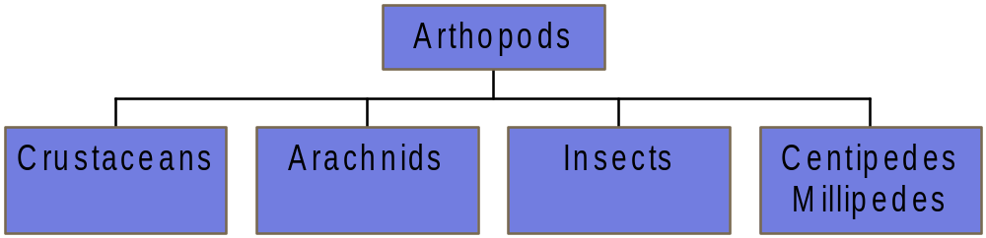
Arthropods
There are 4 groups

Slide 4
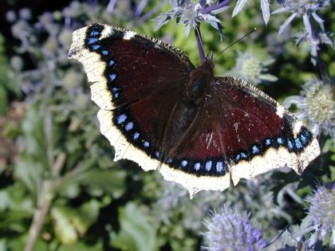
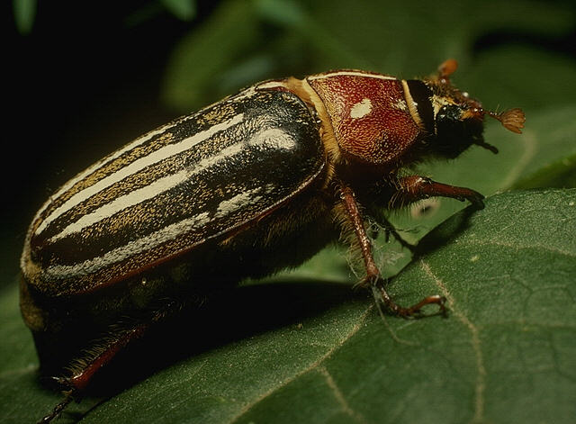
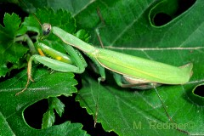
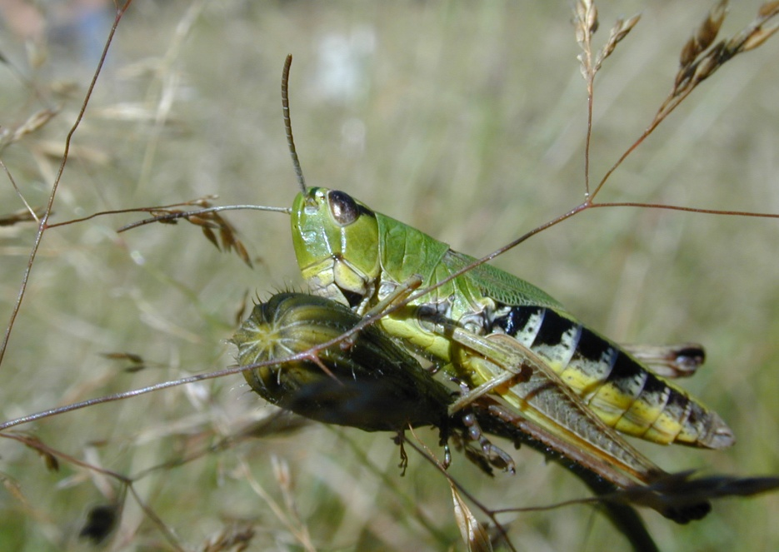
Arthropods - Insects
moth
Have three pairs of jointed legs
Often have two wings – one or both may be vestigial
Breathe through tracheae
Bodies divided into three sections ,Segmented body : head with antenna ,thorax and abdomen
Exoskeleton – prevent water from evaporation
live in very dry places - Terrestrial
beetle
locust
Mantis

Slide 5
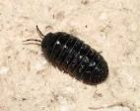
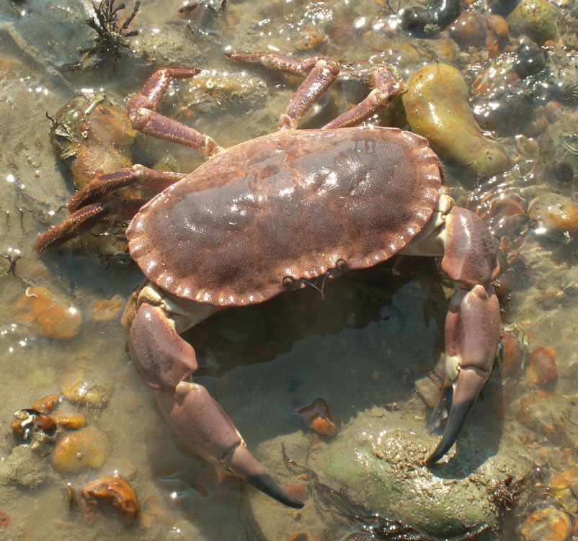
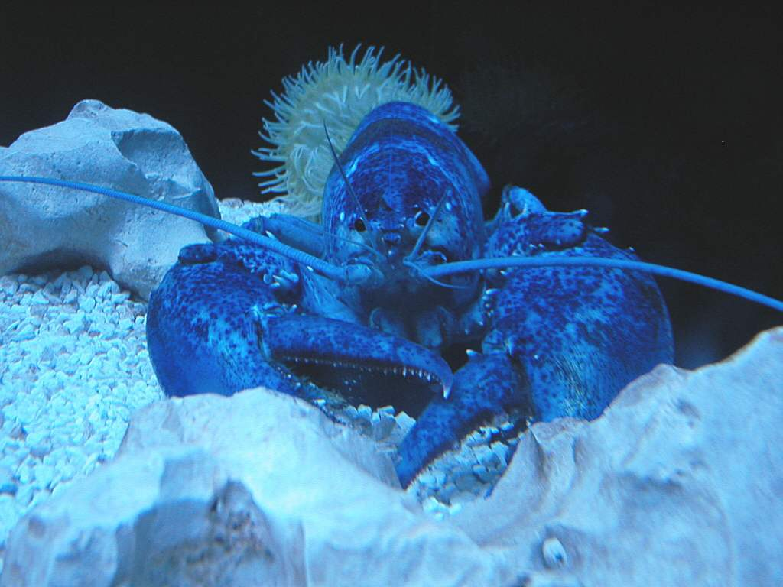
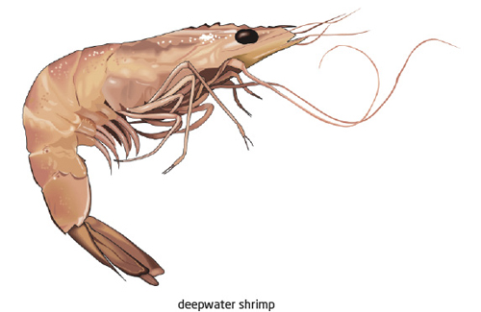
Arthropods - Crustacean
woodlice
Most are aquatic or lives in wet places
Have more than four pairs of jointed legs.
First pair often used as claw
Bodies covered in shell exoskeleton containing calcium salts , also there is antenna
Breathe through gills
Not centipeds or millipedes
Edible crab
lobster
shrimp

Slide 6
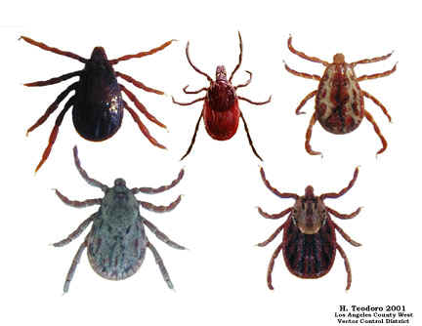
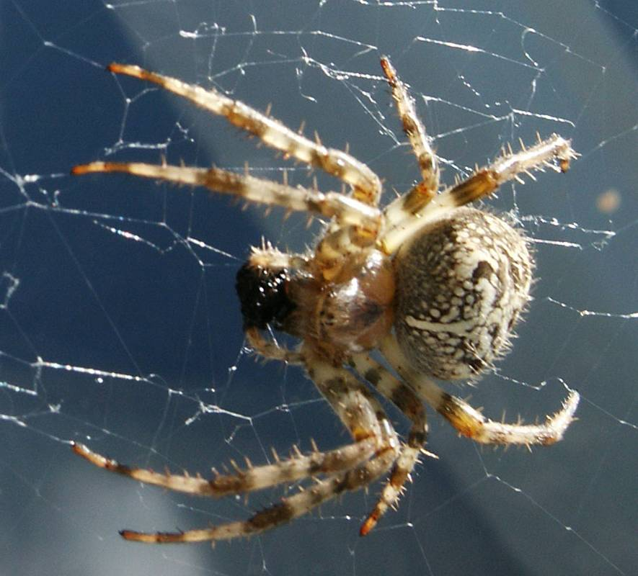
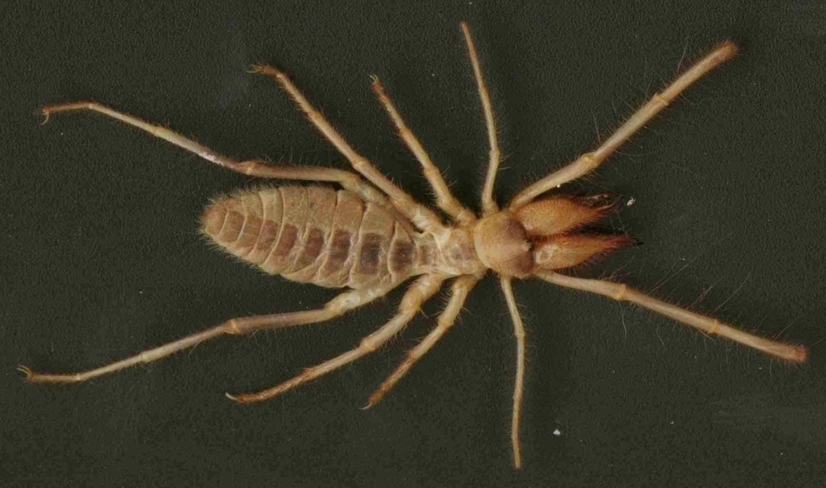
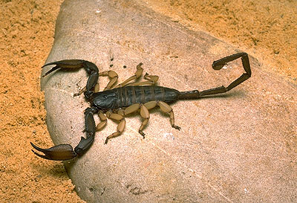
Arthropods - Arachnid
ticks
Have four pairs of jointed legs.
Have bodies divided into two sections , cephalothorax with eyes, abdomen .
Pedipalp :
Land dwelling org.
Breath through gills called book lungs
spiders
Scorpion

Slide 7
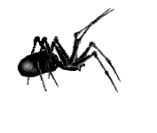

Slide 8
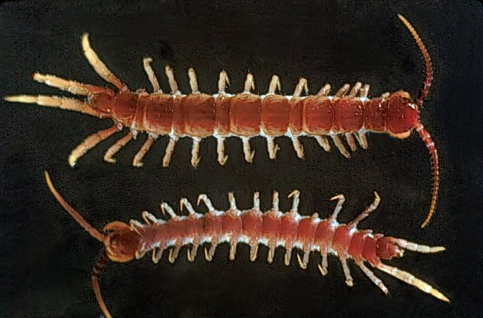
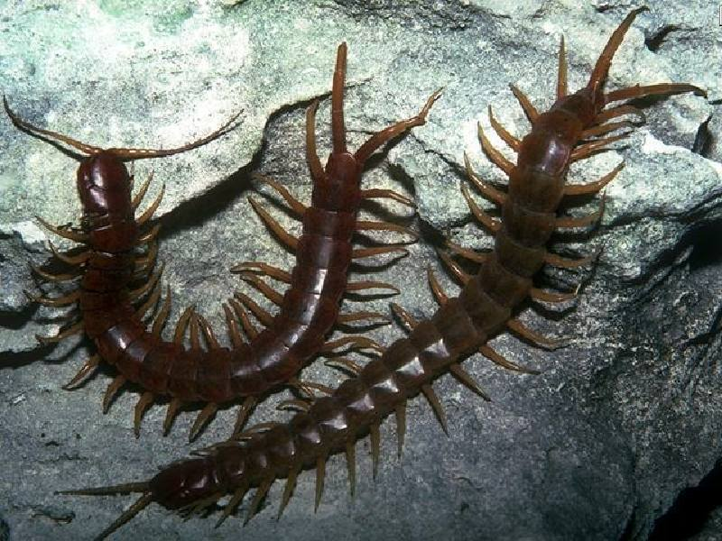
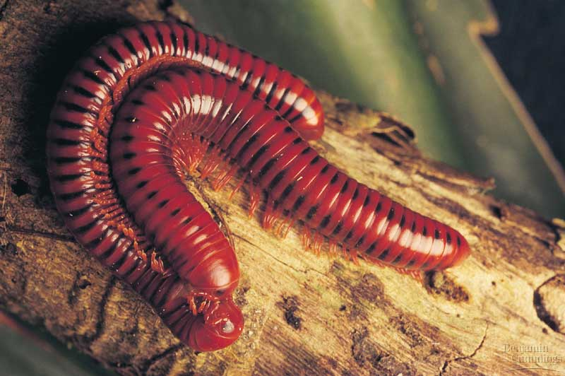
Arthropods – myriapods
Long thin segmented body
Each segment has jointed legs
Centipedes
Millipedes

Slide 9
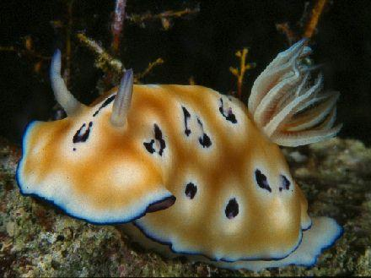

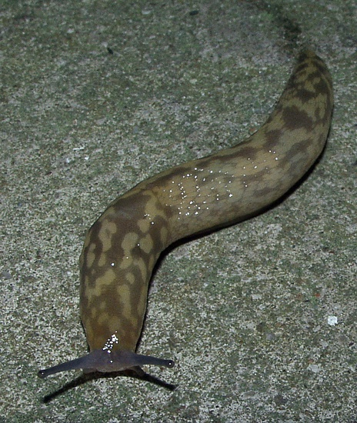
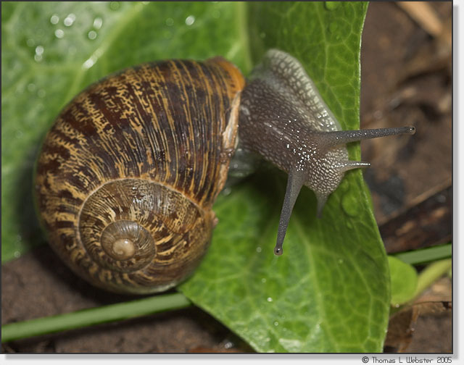
Phylum Molluscs
octopus – internal shill
Soft bodied unsegmented bodies
Can have a coiled shell
snail
slugs

Slide 10
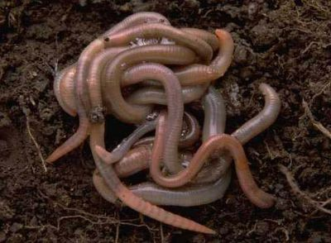
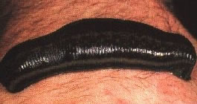
Phylum Annelids
earthworm
Have round worm like bodies made up of ring like segments
Anus : thin side and mouth : wider

Slide 11
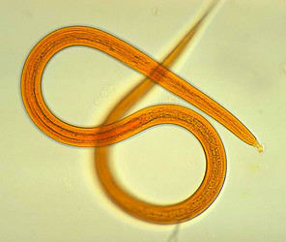
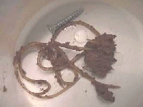
phylum nematodes - Roundworms
Have long thin round worm like bodies with no segments
They usually white

